Slide 1
FINE ARTs MUSIC Portfolio
Carrie Salvatore
ECHE 3315

Slide 2
Portfolio theme
Grade level: Kindergarten
Overarching theme: Fairytales/ Jack and the Beanstalk
Subject focus for Music section: English Language Arts (ELA)

Slide 3
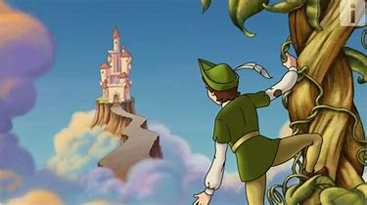
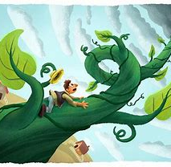

Slide 4
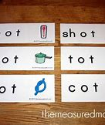
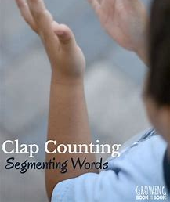
§110.2. English Language Arts and Reading, Kindergarten, Adopted 2017.
(b) Knowledge and skills.
(2) Developing and sustaining foundational language skills: listening, speaking, reading, writing, and thinking--beginning reading and writing. The student develops word structure knowledge through phonological awareness, print concepts, phonics, and morphology to communicate, decode, and spell. The student is expected to:
  identifying the individual words in a spoken sentence;
  identifying syllables in spoken words;
  blending syllables to form multisyllabic words;
  segmenting multisyllabic words into syllables;

Slide 5
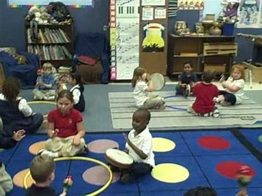
§117.103. Music, Kindergarten, Adopted 2013.
(b) Knowledge and skills.
2) Creative expression. The student performs a varied repertoire of developmentally appropriate music in informal or formal settings. The student is expected to:
(A) sing or play classroom instruments independently or in groups;
(C) move alone or with others to a varied repertoire of music using gross and fine locomotor and non-locomotor movement;
(E) perform music using louder/softer and faster/slower.

Slide 6
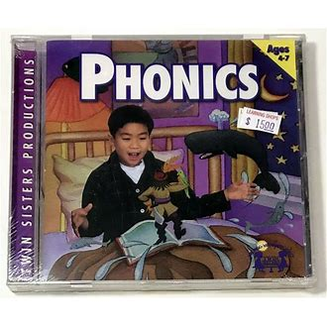
SEALED Phonics Children's CD (Twin Sisters, Twin 105 CD, Ages 4-7, 2001)
I would incorporate this CD into a reading lesson or activity so that way they could follow along with the CD activities but still feel a sense of independence and academic achievement individually or in groups in the classroom.

Slide 7
Song selection for singing
https://youtu.be/vlBc703kYMg
LYRICS:
Lyrics: Clap, Stomp and Chomp (Syllable Song) Make your hands Clap, Clap, Clap Make your feet Stomp, Stomp, Stomp Make your arms Chomp, Chomp, Chomp Now listen carefully Everybody follow me and Move, Move, Move to the syllables in words Let’s clap! Class - room Mon - key Yel - low Dog Sat – ur - day Rain - bow Make your hands Clap, Clap, Clap Make your feet Stomp, Stomp, Stomp Make your arms Chomp, Chomp, Chomp Now listen carefully Everybody follow me and Move, Move, Move to the syllables in words Let’s stomp! Com – pu - ter Food Pig Ap - ple Prin – ci - pal Foot - ball Let’s chomp! Di – no - saur Rain Sun - shine Go – ril - la Mon - ster Bi – cy – cle Make your hands Clap, Clap, Clap Make your feet Stomp, Stomp, Stomp Make your arms Chomp, Chomp, Chomp Now listen carefully Everybody follow me and Move, Move, Move to the syllables in words It’s Fun!

Slide 8
SONG SELECTION EXPLANATION
This educational interactive song helps children to hear the syllables in varying syllables throughout multiple words and helps to develop their phonological awareness skills. The song is extremely clear for young students to understand and also extremely catchy and it entices and engages children with effective visuals, words, and active movements through clapping, stomping and chomping with their hands or arms. This syllable song is perfect for kinesthetic learners as they can visually see the movements being done and replicate them while utilizing auditory clues through singing the words back from the video. I chose this song because syllabication is an extremely important skill in being able to successfully develop your students phonological awareness which is essential skills for developing readers and learners for the grade levels to come. I will incorporate this into the lesson plan by using this as an interactive video after reading the jack and the bean stalk book to the classroom in which I will be pointing out syllables in key words.

Slide 9
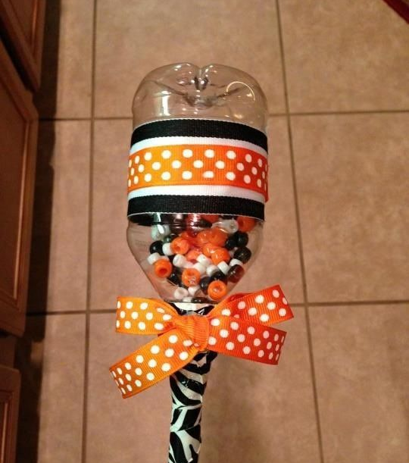
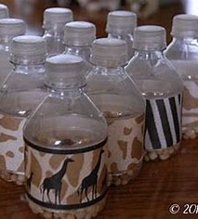
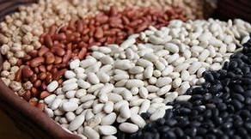
Magic bean music shakers
DIRECTIONS:
STEP 1: Get empty bottle or container
STEP 2: Fill to one of the level lines in the bottle with beans or jellybeans and put the lid or cover back on
STEP 3: Decorate with art supplies (paint, tissue paper, pipe cleaners, toothpicks, paper, sponges, ribbon etc.)
STEP 4: Use the shakers to shake out syllables in various words presented in the classroom and at home.

Slide 10
Magic Bean shakers LESSON PLAN
3315 Lesson Plan
Engagement/Connecting to Prior Knowledge | Today I will start off by reading to you the story of Jack and the Beanstalk. Raise your hand if you have heard the story of Jack and the Beanstalk before! Can anyone tell me what they know about beans? Has anyone every eaten a bean? Does anyone know what color a bean can be? Tell me some of your thoughts as a class! While reading the book I will stop and point out syllables in key words. After reading the story I will put on the phonics CD for a small interactive group activity before beginning the lesson for the day. It can also be used as transition music.
Teaching Point | “Today, I want to teach you how to demonstrate phonological awareness by identifying syllables in spoken words and segmenting multisyllabic words into syllables using a magic bean shaker that will be creating in the classroom today.” ”Watch me as I build a magic bean shaker!”
Teach | First, we are going to watch this syllable song and sing along and follow along with the dances moves and motions done to each part. After watching the video I want you all to watch me break down this example using the shake method with the magic bean shakers and then you can make you shakers and break apart the words provided. Example: Listen to me as I break apart the sentence in segments on the board… “Look at that big brown bear swim First, … Look (Shake) Then, … Look (Shake) at (Shake) Then, … Look (Shake) at (Shake) that (Shake) Then, … Look (Shake) at (Shake) that (Shake) big (Shake) Then, … Look (Shake) at (Shake) that (Shake) big (Shake) brown (Shake) Then, … Look (Shake) at (Shake) that (Shake) big (Shake) brown (Shake) bear (Shake) Finally, … Look (Shake) at (Shake) that (Shake) big (Shake) brown (Shake) bear (Shake) swim (Shake) . Did you see how I used my magic bean shaker to shake for each word and broke the sentence down into segments.

Slide 11
LESSON PLAN CONTINUED
Active Engagement
Now it’s your turn to try it out...
Each one of you will take a water bottle and pick a bean level for your shaker to fill up to with beans and then screw the cap back on and decorate the outside with provided materials.
Each student will get into the designated student reading groups and use their shakers to break apart sentences into segments and sound out syllables of words to expand their reading comprehension.
After this group activity I will have a live music performing artist Bob McGrath to sing a syllable phonics song to the classroom and I want you all to get on your feet and participate and have fun!
Performance starts~
Link/Check for understanding
“Today we learned how to segment out sentences and break down syllables in words through using our magic bean shakers.” These magic bean shakers allowed us to add in music to the reading lesson and provide auditory cues to our ears as we build our reading comprehension. Tell me something you learned or enjoyed through todays reading lesson and music activity!

Slide 12
Visiting live performer
Name: Bob McGrath
Residency: Illinois
Contact: http://www.bobmcgrath.com/news-reviews/
I chose Bob McGrath as the live visiting artist because he was on sesame street and is an active singer in children’s education and I knew he could cater to whatever I needed him to perform such as a song about syllables in the classroom. He would be focusing on the objective of students being able to identify multisyllabic and singular syllable words through the use of clapping or shaking their instruments. Their visit would be beneficial to the students as it would excite and spark each students interest in music and phonological awareness in the classroom and get them ready for reading in the classroom for the years to come.

Slide 13
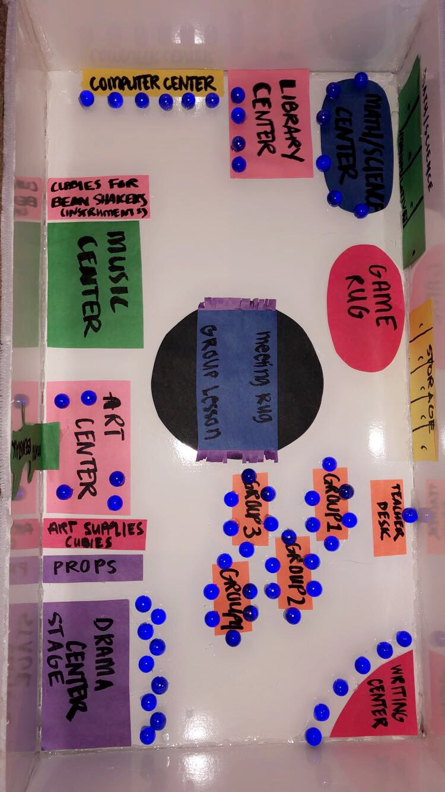
Music center floor plan and center information
Materials: In the center there will be a wall of musical instruments such as classroom bongos, triangles, tambourines and a small keyboard etc. There will also be cubbies for the students to put their magic bean shakers after each use so they can be utilized all year long. There will be simple music sheets for students to collaborate on. There will also be syllable word cards all over the center so students can utilize the instruments to help expand their phonological awareness.
Goals: The goals of this center will be to utilize student's musical knowledge and expand their motor skills through musical understanding while having them identify syllables in various words.
Skills: Students will need to possess good listening and participation skills throughout this center to maintain active and successful achievement through learning and understanding music while applying it to their phonological practice.

Slide 14
ASSESSMENT INFORMATION
The purpose of these three assessments I found are to successfully benefit the students by assessing their knowledge, comprehension and understanding of the lesson on being able to identify, write and represent syllables and multisyllabic words given.
These assessments will gage their overall understanding on the topic at hand of identifying and representing syllables in given words through recognition to allow for the instructor to see where each student sits at with their individual phonological skills.

Slide 15
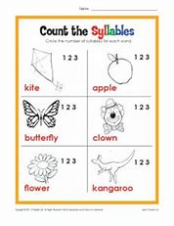
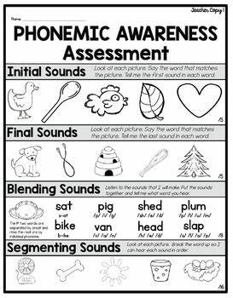
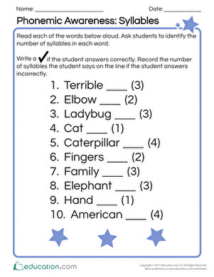
Assessment instruction

